Slide 1

Movie Popularity and Target Audience Prediction using Content - Based Recommender System
Under the Guidance of
Mrs. CH Chandrika Surya
Presented By:
20EM1A6110(G.B.S.V.M Dharmendra)
20EM1A6107(D.S.k. Chaitanya varma)
20EM1A6129(N Krishna Vamshi)
20EM1A6115(K.M.Soma Sekhar)

Slide 2
Movie Popularity and Target Audience Prediction using Content - Based Recommender System
The movie is one of the integral components of our everyday entertainment. The worldwide movie industry is one of the most growing and significant industries and seizing the attention of people of all ages. It has been observed in the recent study that only a few of the movies achieve success.

Slide 3

Objectives:
Clear objectives of the project:
Predicting movie popularity based on various features.
Predicting target audience demographics for movies.
Enhancing movie recommendations using machine learning techniques.

Slide 4
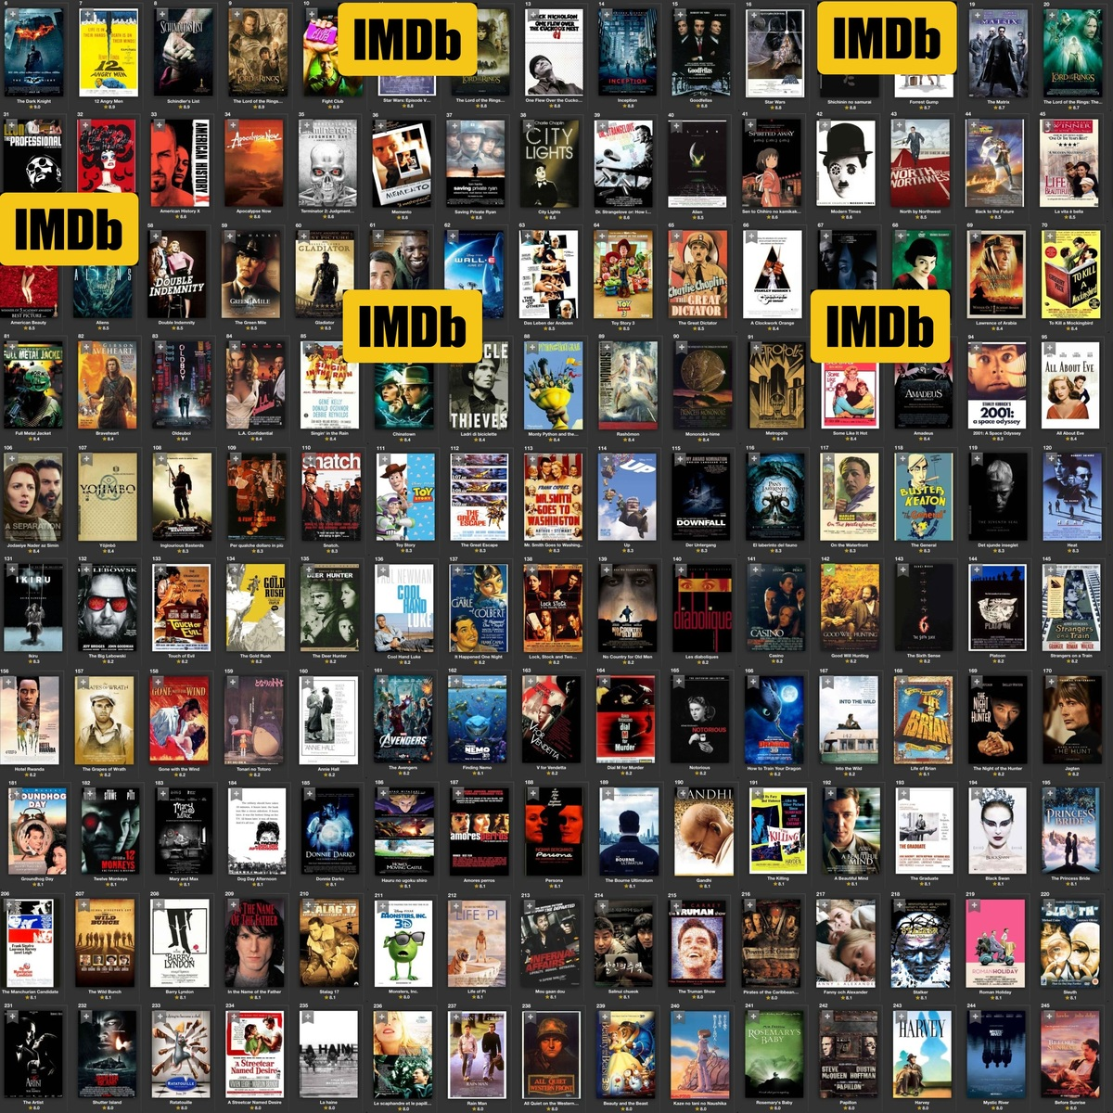
Data Collection
Sources of data: IMDb, TMDb, Kaggle datasets, etc.
Overview of the data attributes/features:
Movie metadata (genre, cast, crew, release year, etc.).
Ratings and reviews.
Demographic information (if available).

Slide 5
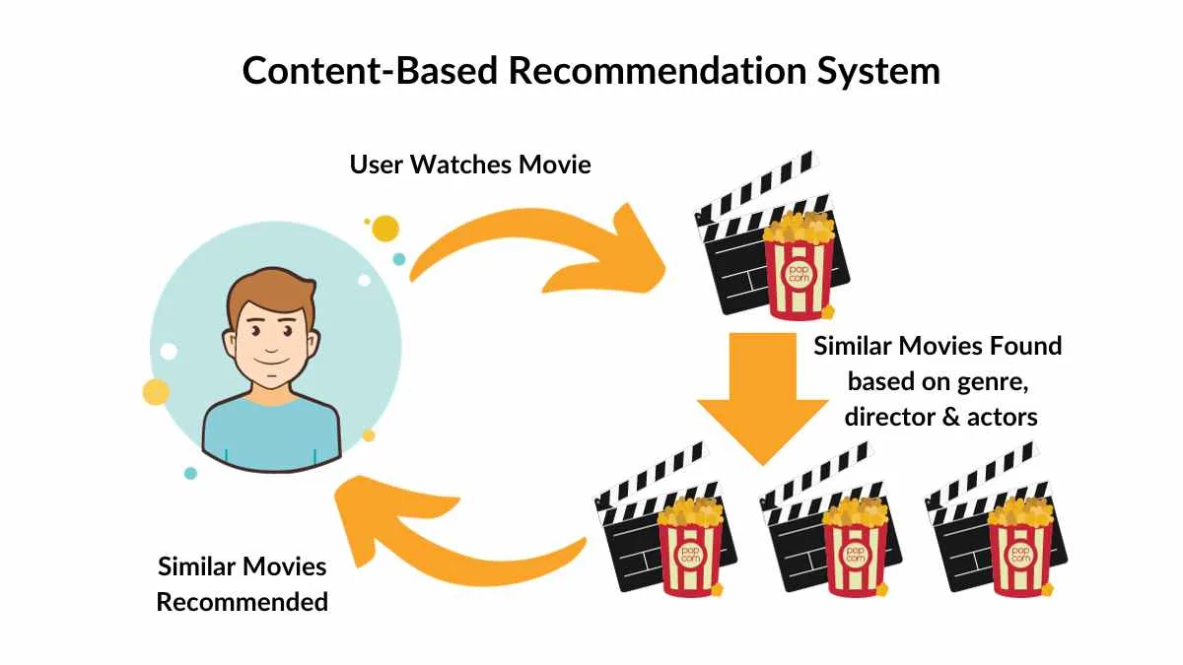
Building the Content-Based Recommender System
Overview of the recommender system:
Similarity calculation between movies based on features.
Popularity prediction using regression models.
Target audience prediction using classification models.

Slide 6
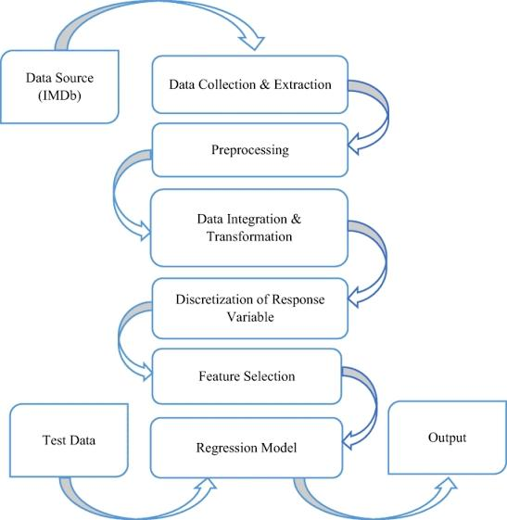
Movie Popularity

Slide 7

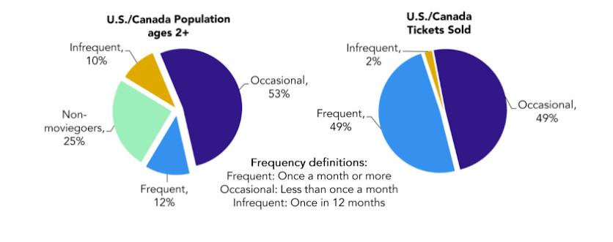
Target Audience

Slide 8
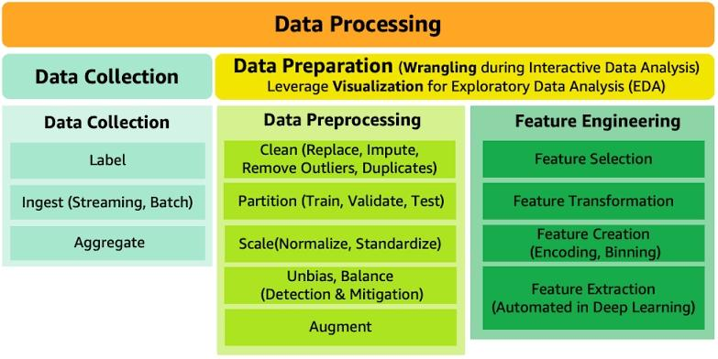
Data Preprocessing

Slide 9
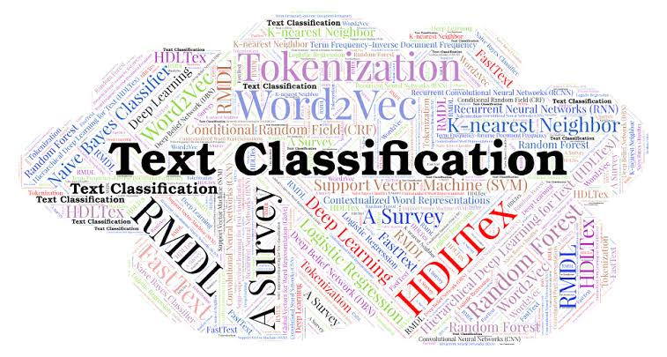
Classification with KNN

Slide 10
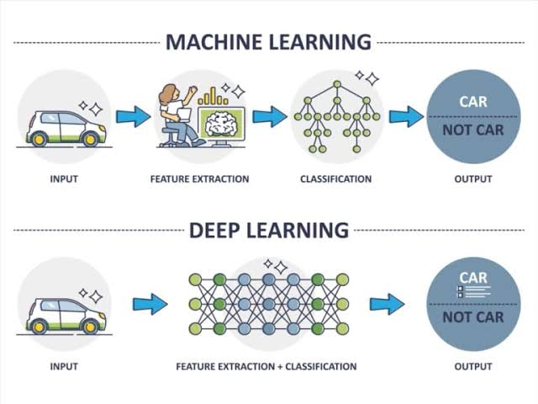
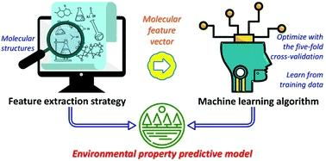
Feature Engineering

Slide 11
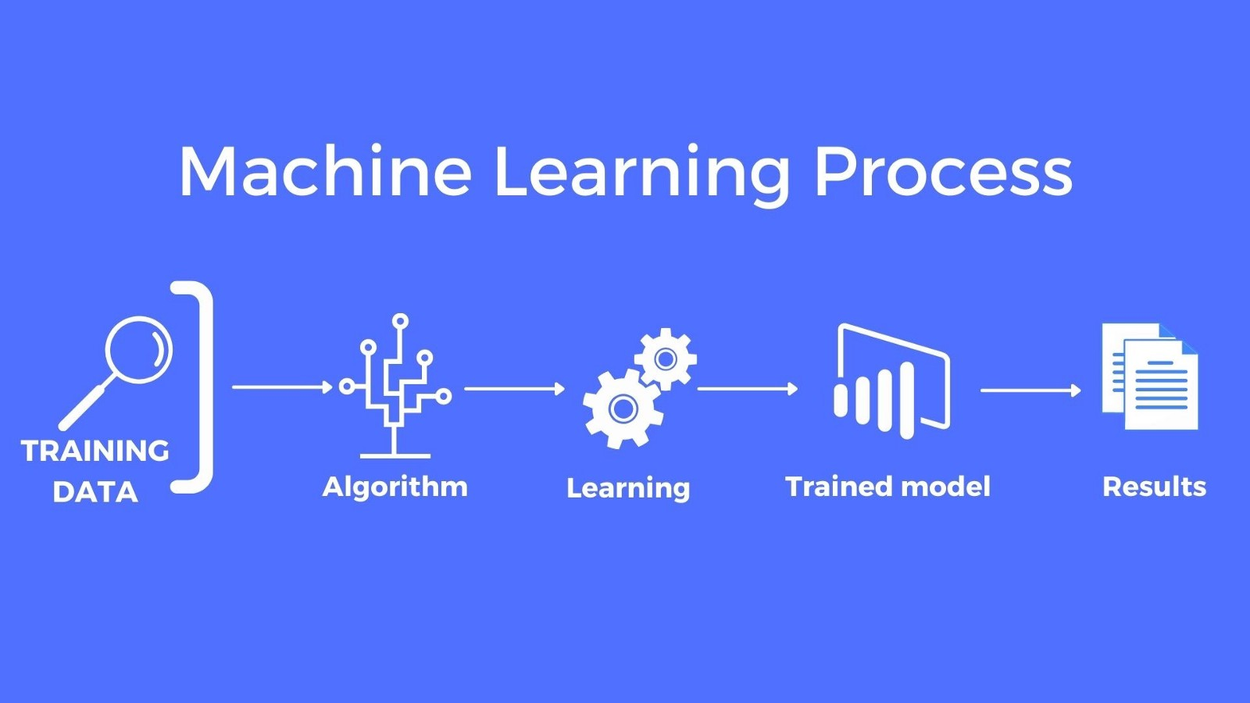
Model Training
Description of the machine learning models used
Regression model for predicting movie popularity
Classification model for predicting target audience demographic
Training process and evaluation metrics used.

Slide 12
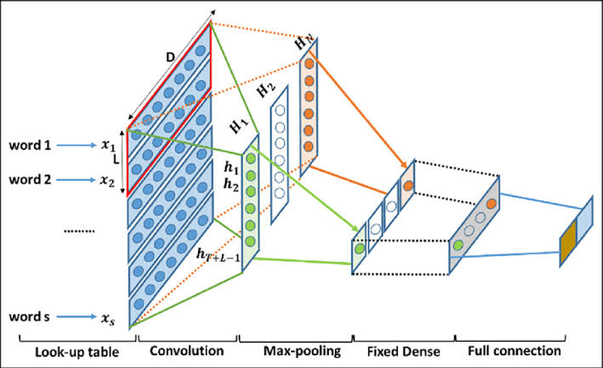
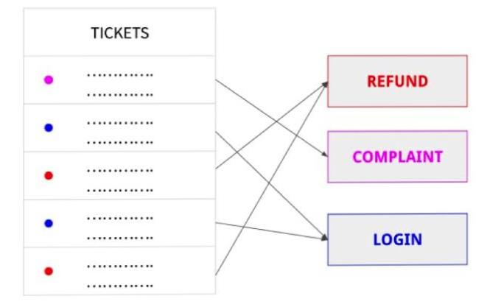
Feature Extraction with CNN

Slide 13
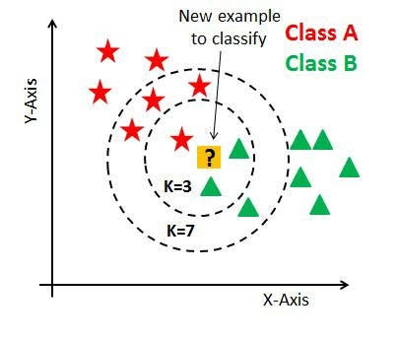
Model Evaluation
Cosine Similarity
Implementation Cosine Similarity in Knn algorithm
Define cosine similarity as a measure of similarity between two non-zero vectors in an inner product space. Explain that cosine similarity measures the cosine of the angle between the two vectors, representing the degree of similarity between them.

Slide 14
Deployment and Integration
Deployment options:
Web application, mobile app, or integrated into existing platforms.
Integration with streaming platforms or cinemas for personalized recommendations.
Ensuring scalability and real-time performance.

Slide 15
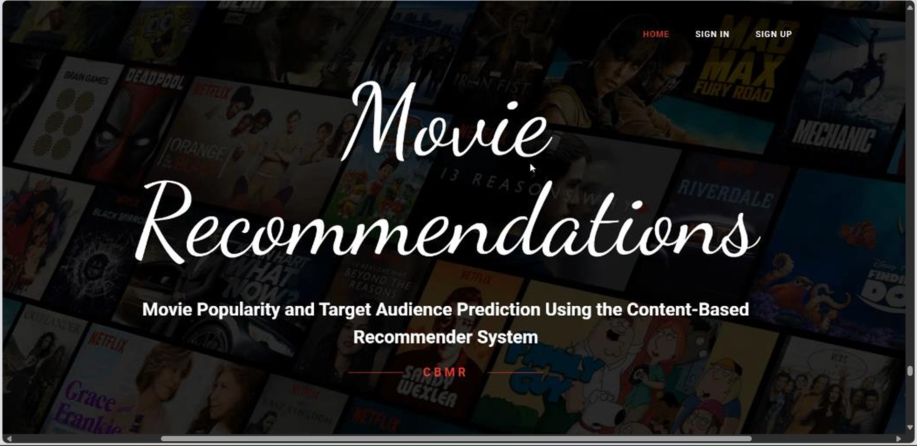
Screen shots

Slide 16
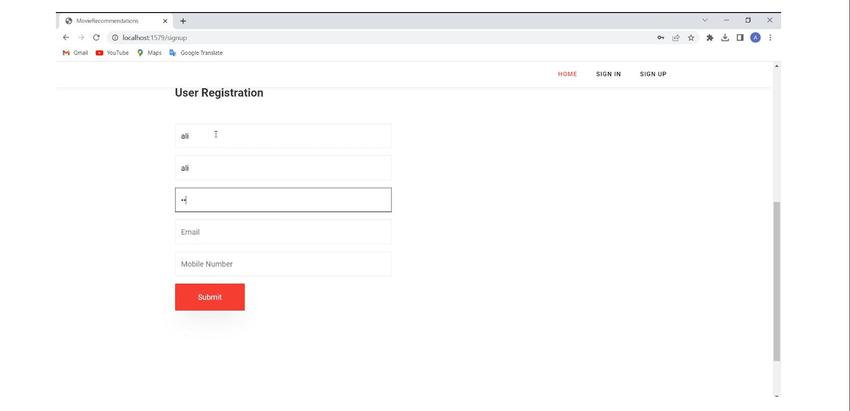
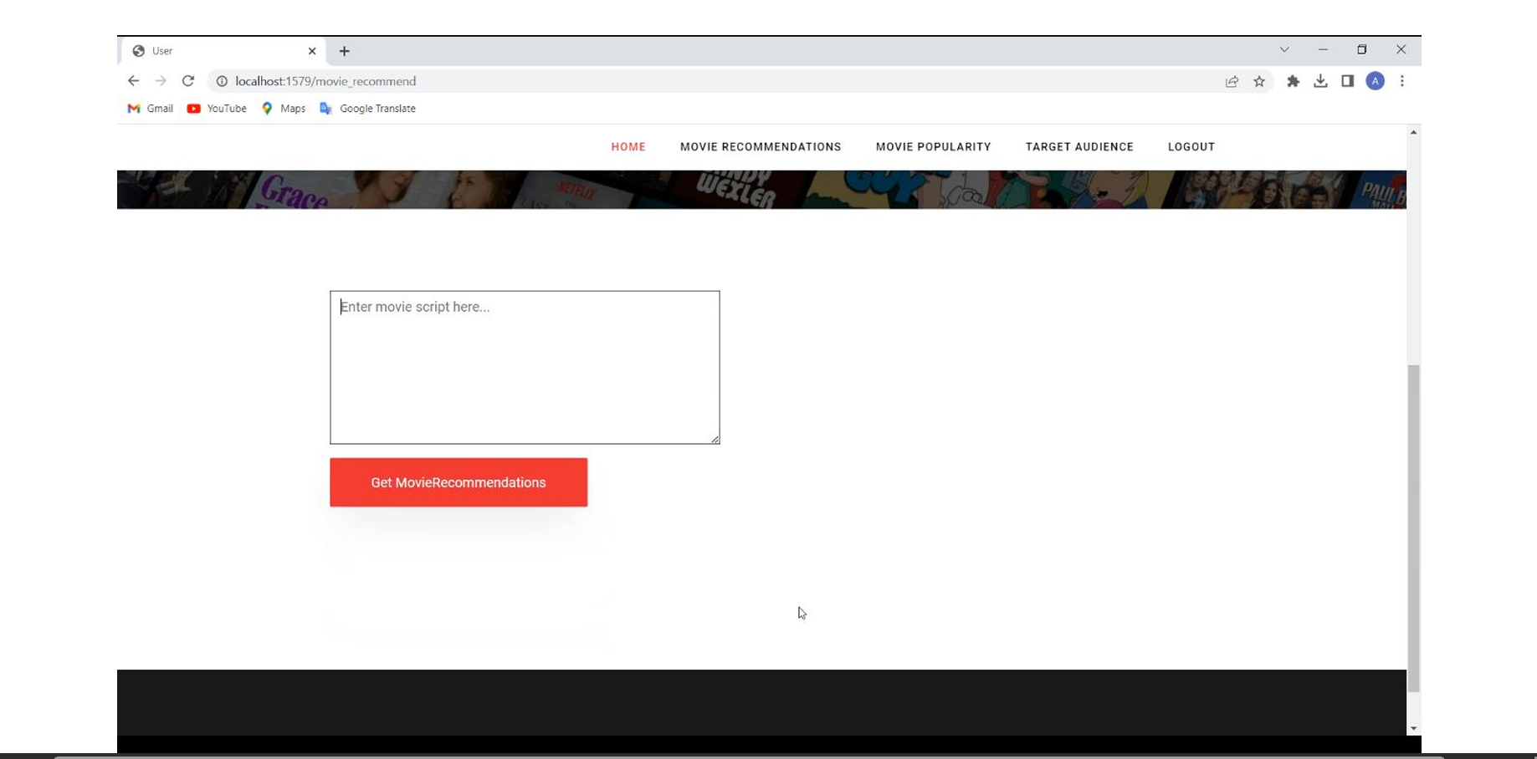
Screen shots

Slide 17
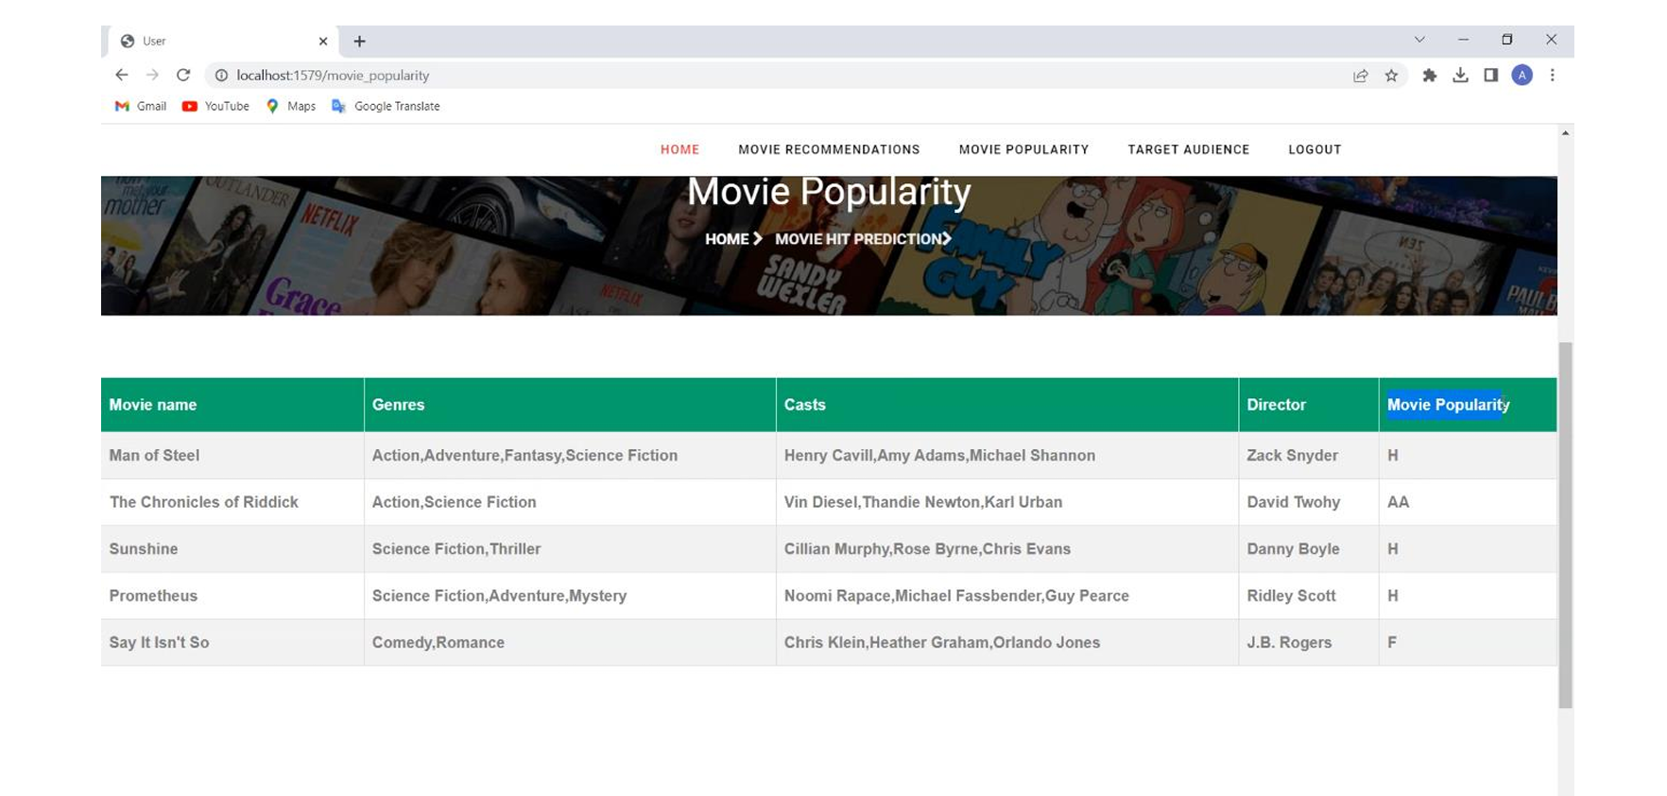
Screen shots

Slide 18

Summary of key findings and contributions:
Successful development of a content-based recommender system for movie popularity and target audience prediction.
Improved movie recommendations for users and enhanced business outcomes for platforms.

Slide 19
Thank You

